Slide 1

Activate Good Final Presentation
Team 1

Slide 2
Outline
Semester Overview
Background
Demos
Interviews and Studies
Inbox

Slide 3
Outline
Semester Overview
Background
Demos
Interviews and Studies
Inbox

Slide 4
Semester Overview
Phase 1: Get to know volunteers
Phase 2: User study on Activate Good
RQ: How do users search for and select opportunities on activategood.org?
Phase 3: Provide design recommendations

Slide 5
Outline
Semester Overview
Background
Demos
Interviews and Studies
Inbox

Slide 6
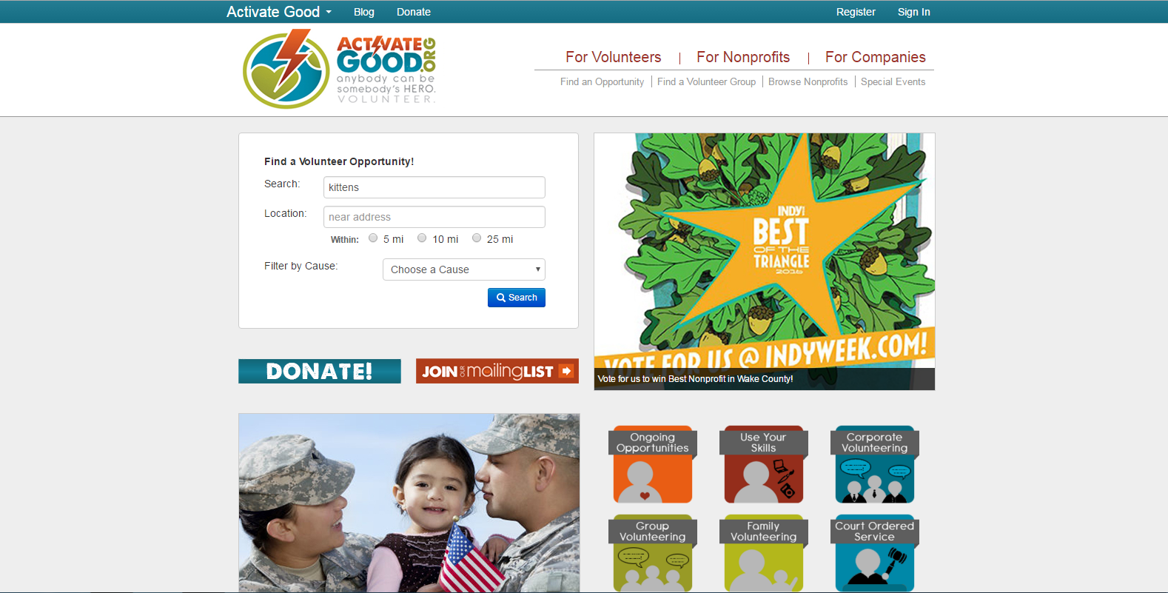

Slide 7
Notes:
Scope: how do volunteers search for and select opportunities

Slide 9
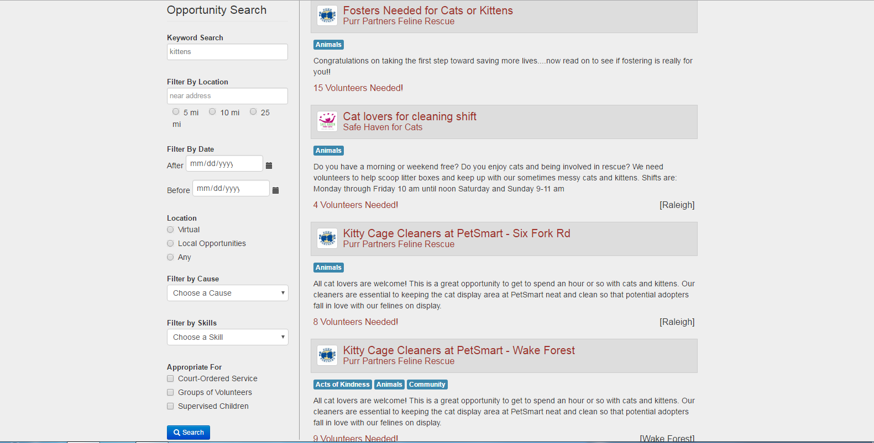

Slide 10
Outline
Semester Overview
Background
Demos
Interviews and Studies
Inbox

Slide 11
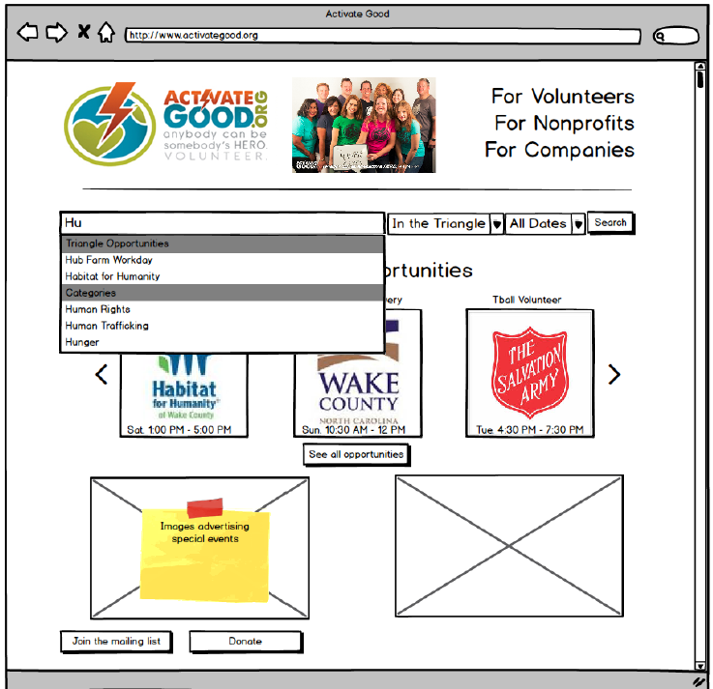

Slide 12
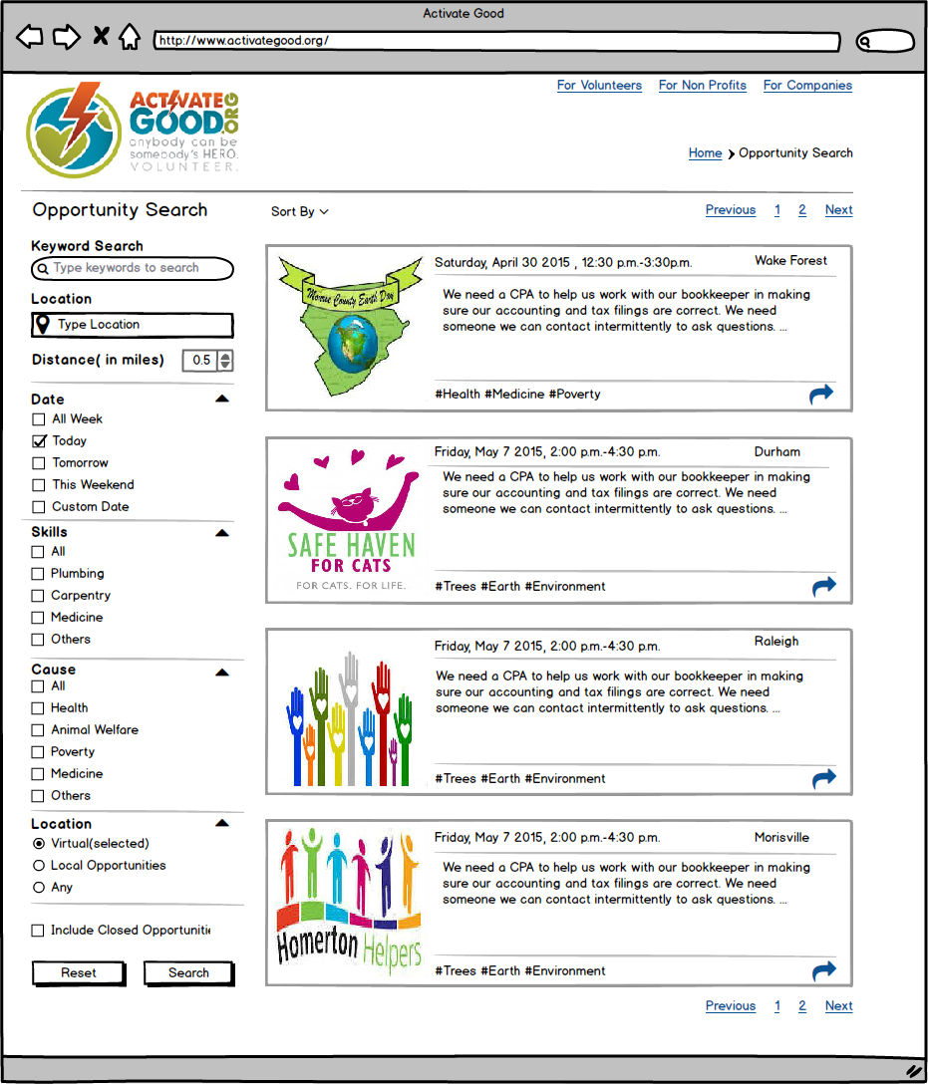

Slide 13
Outline
Semester Overview
Background
Demos
Interviews and Studies
Inbox

Slide 14

Interview Methodology
Interview 15 participants
Discuss volunteering
What motivates you?
How do you decide what opportunities to volunteer for?

Slide 15




Personas
Lone Wolf: Rather than volunteer with her friends or peers, the lone wolf is comfortable attending volunteer opportunities on her own. She uses the event to meet new people and connect with her community. Busy Bee: This person is interested in volunteering, but is perhaps too busy to commit to ongoing opportunities. She prefers one-time volunteer opportunities. Shepherd: The shepherd herds others to volunteer opportunites. When she decides to volunteer, she encourages others in her social circle to join her. The shepherd enjoys volunteering with familiar people and will seek opportunities to do so. The Follower: The follower won’t typically seek volunteer opportunities on her own. Not that the follower avoids volunteering at all costs. Rather, the volunteer prefers to participate in opportunities that have been endorsed by others they trust.

Slide 16


User Study Methodology
Recruit 15 Participants
Participants used the site to find a volunteer opportunity
Collected:
Screen
Audio
Net Promoter Score (x2)
Demographics
Jointly identified pain points

Slide 17
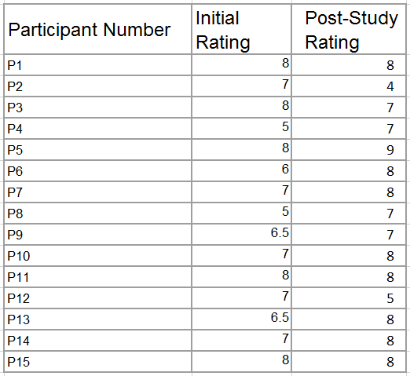
Net Promoter
Notes:
How likely to recommend the site to a friend or colleague

Slide 18
Homepage: Distractions and Organization
Notes:
Greeted by “advertisements” made participants wary of the site
Home Page Design - Some participants thought the site was untrustworthy with the large ads. The two search related boxes were not grouped. Donate and mailing list out of context. Participant didn’t notice search box instead clicked for volunteers. Some felt content was crammed.

Slide 19
Homepage: Keyword vs. Causes
Notes:
Keyword/Cause Confusion - Participants thought keyword search and causes were too similar.

Slide 20
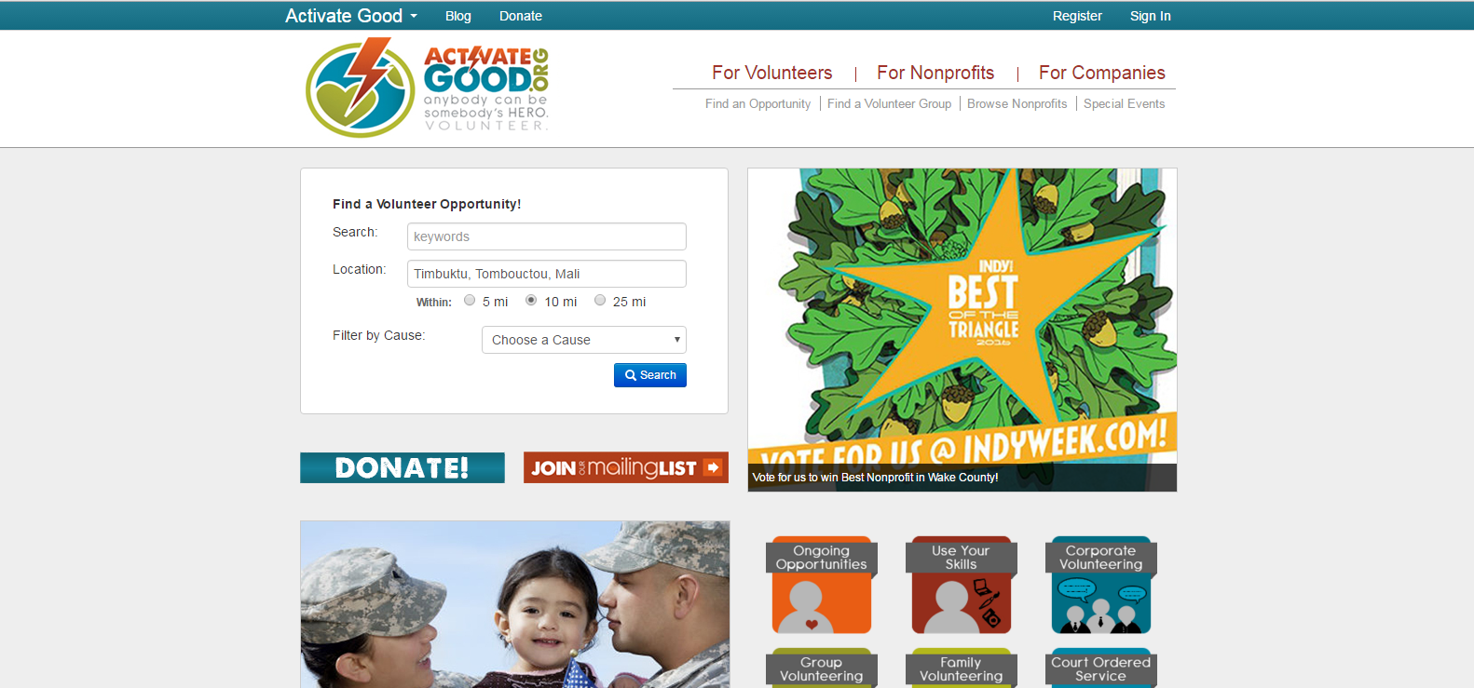
Homepage: Triangle Only?
Notes:
Just in the Triangle - Searching outside the triangle doesn’t return results. Should be an explicit warning. P5 kept searching in virginia or DC.

Slide 21
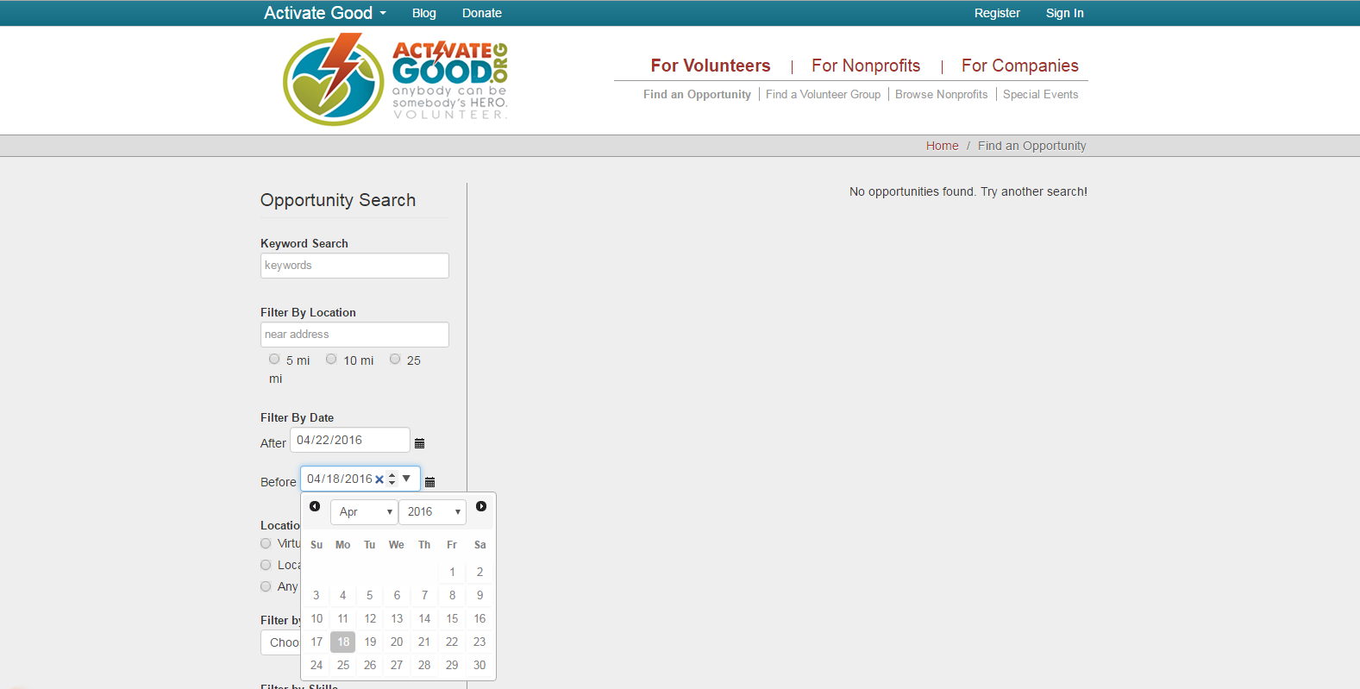
Results: Datepicker Confusion

Slide 22
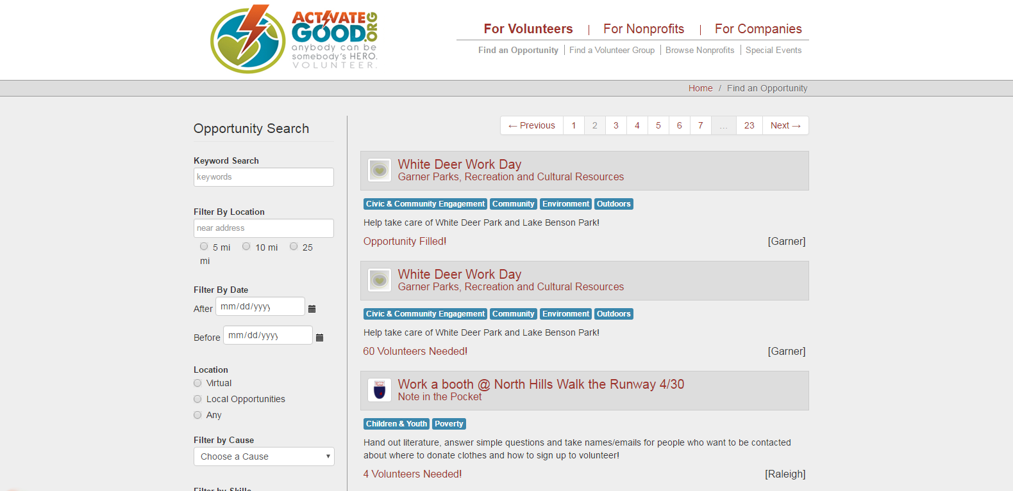
Results: List Structure
Notes:
What separates the results? Why am I seeing filled opportunities? Bracketed locations are strange, 60 volunteers needed misleading split over different sessions, Sorting?

Slide 23
Outline
Semester Overview
Background
Demos
Interviews and Studies
Inbox

Slide 24
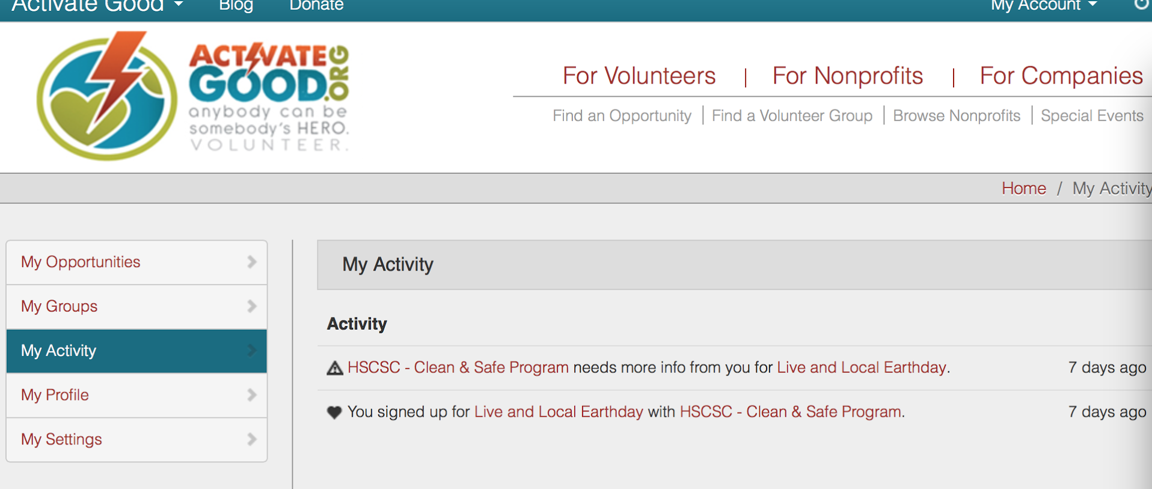
Am I signed up?

Slide 25
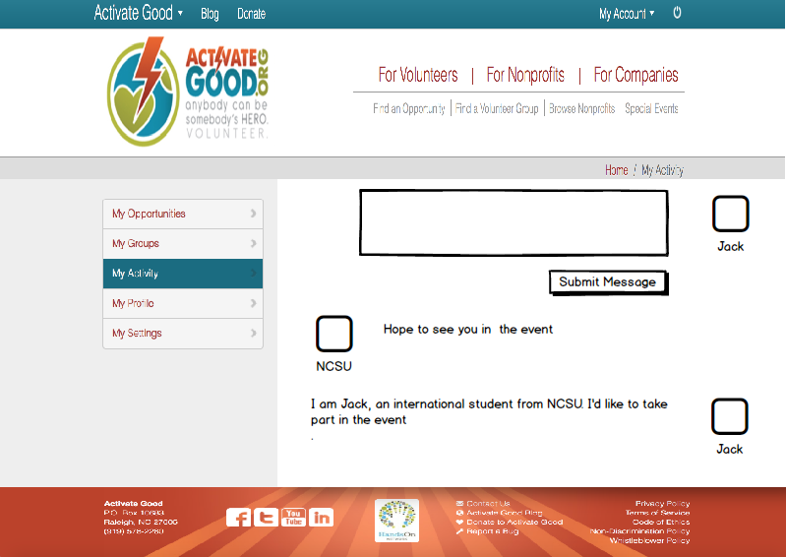
Demo Inbox Mockup

Slide 26
